Slide 1
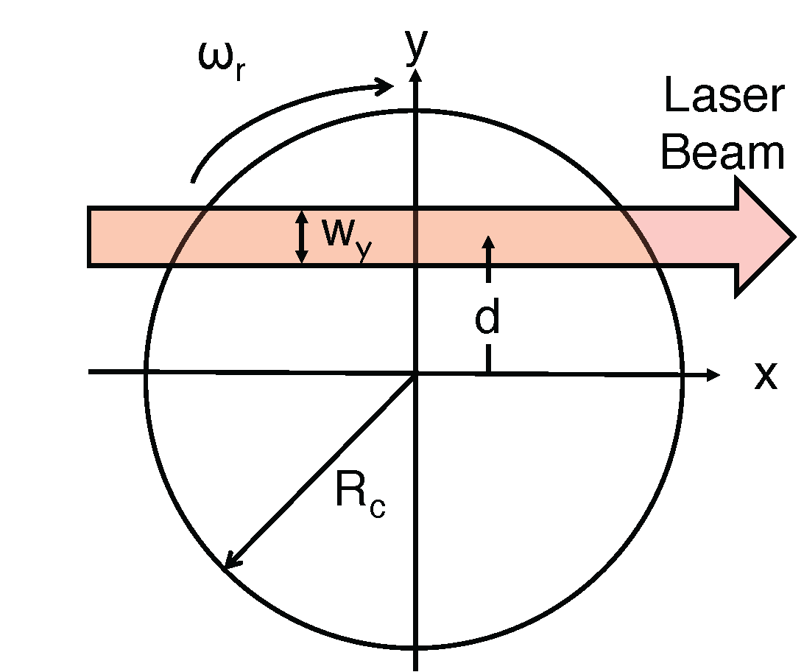
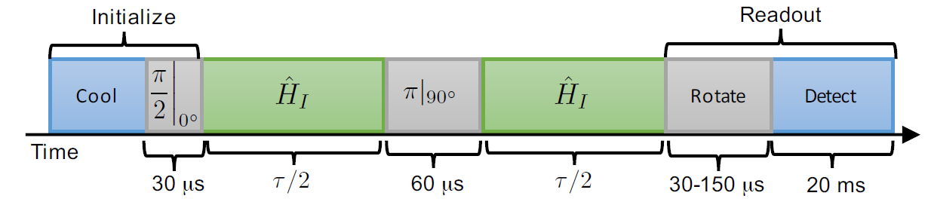
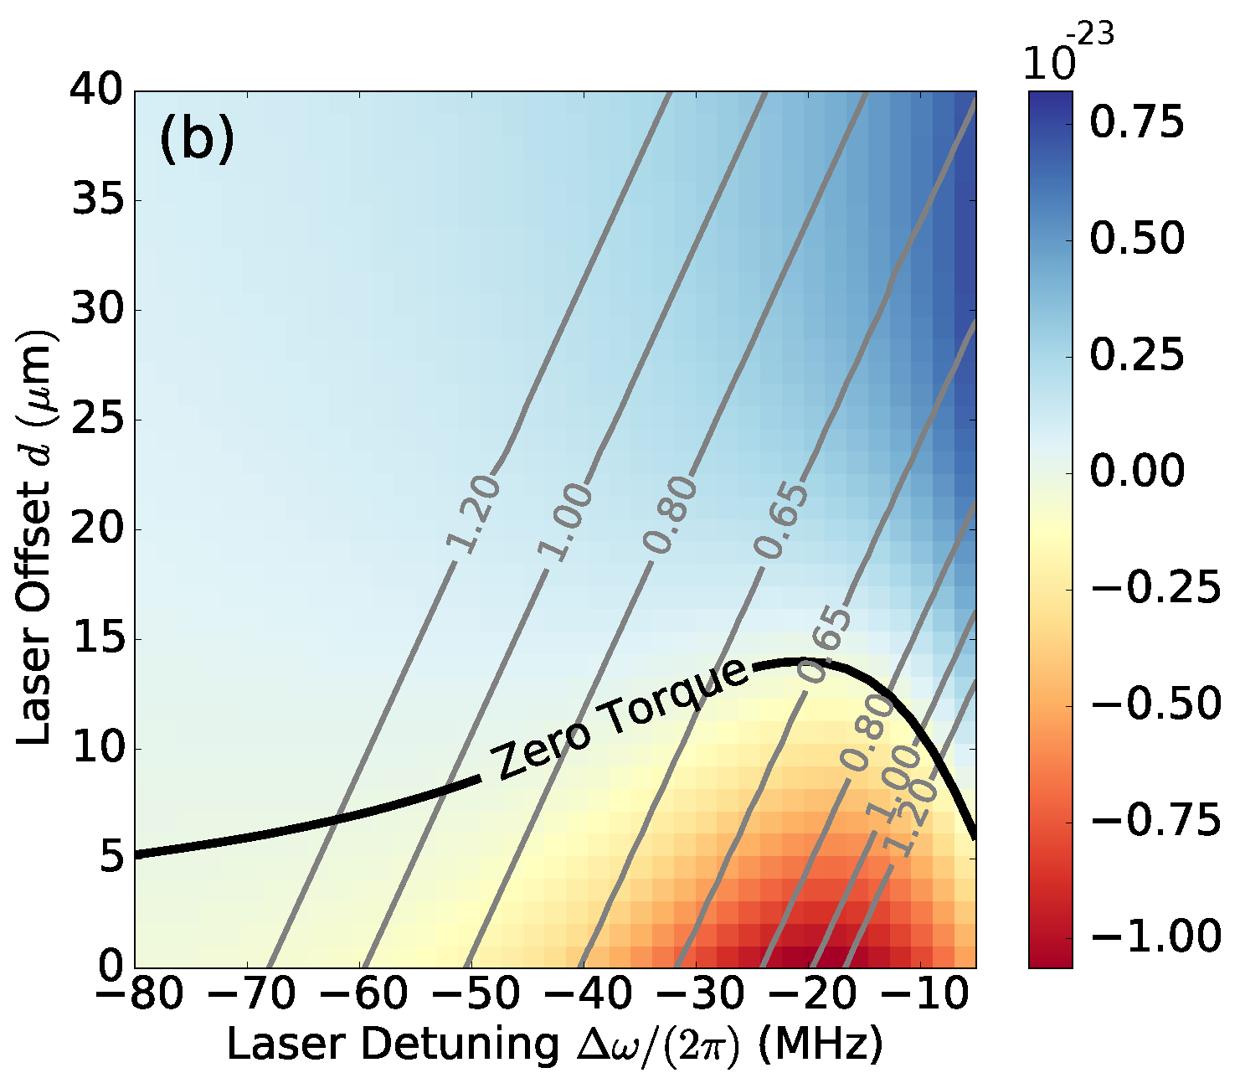
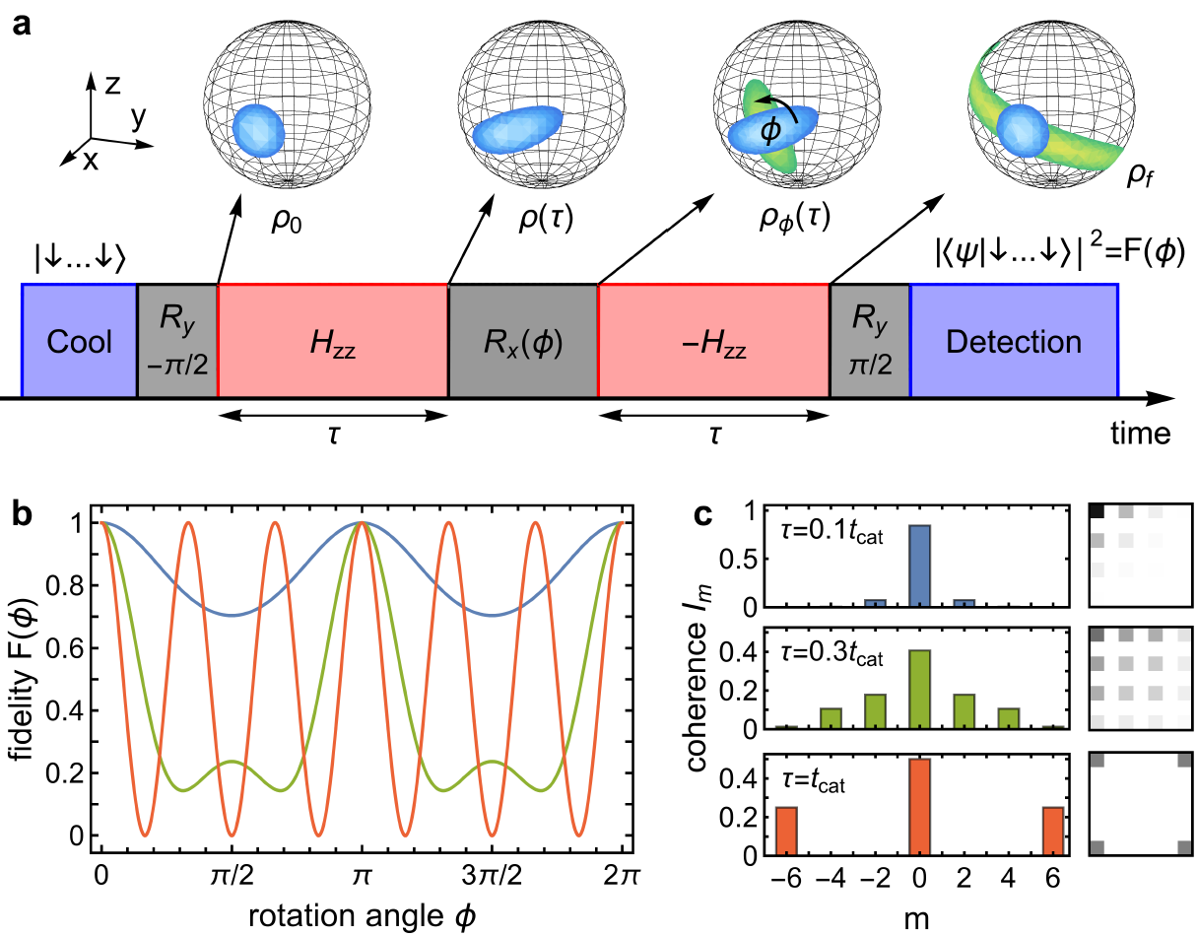
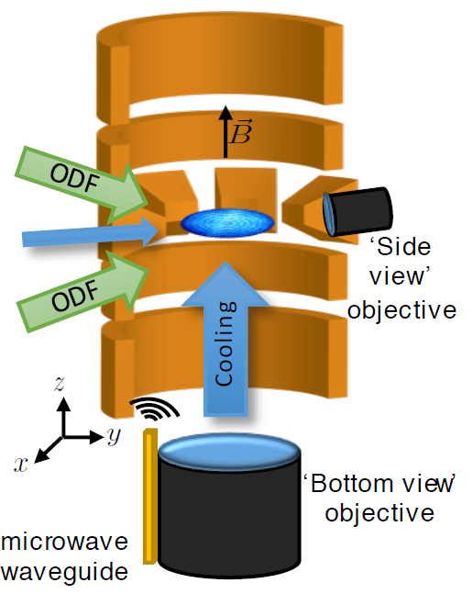
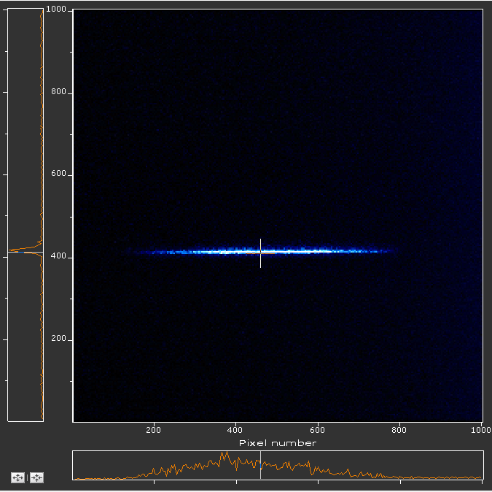
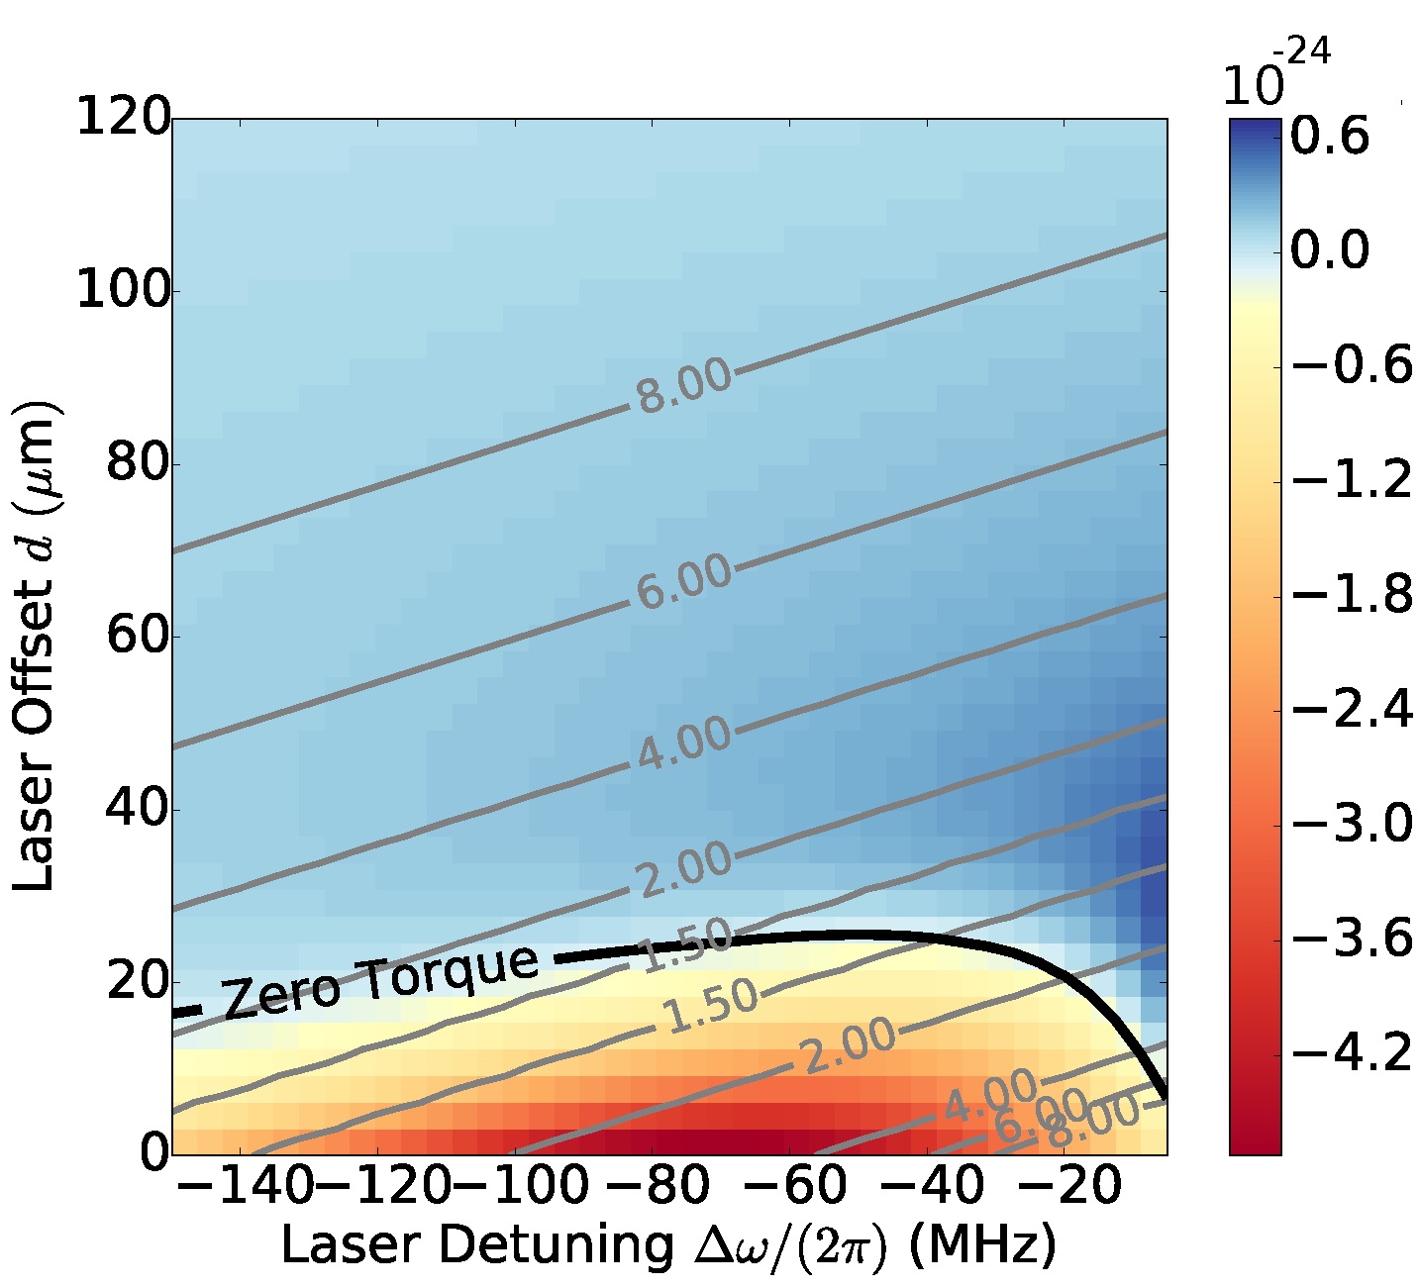
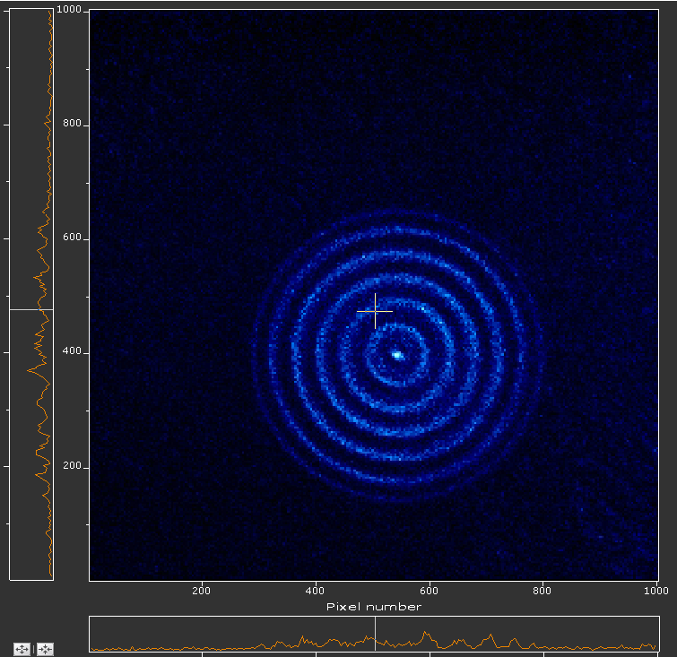
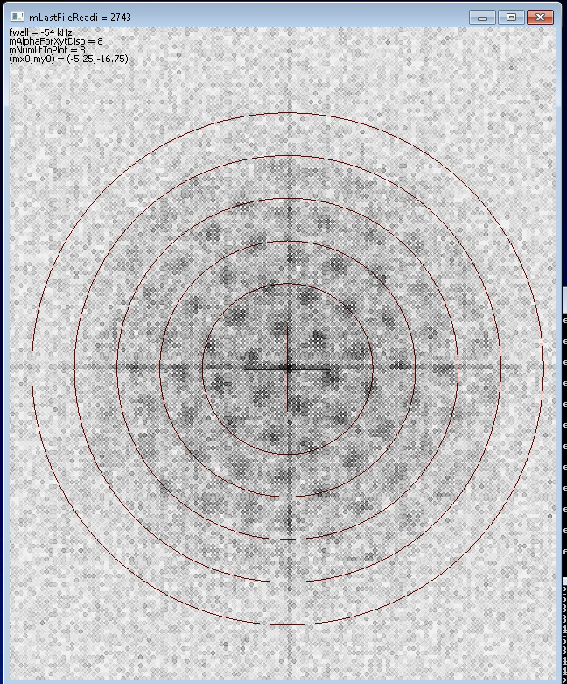
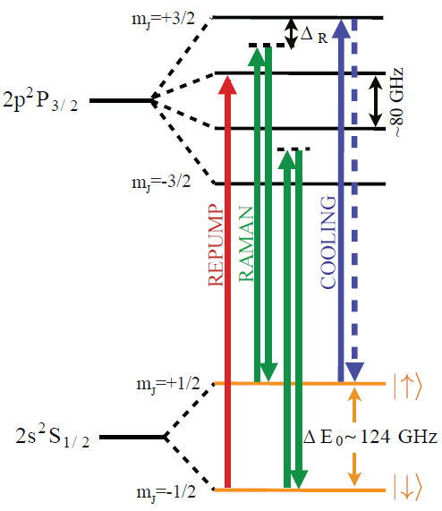
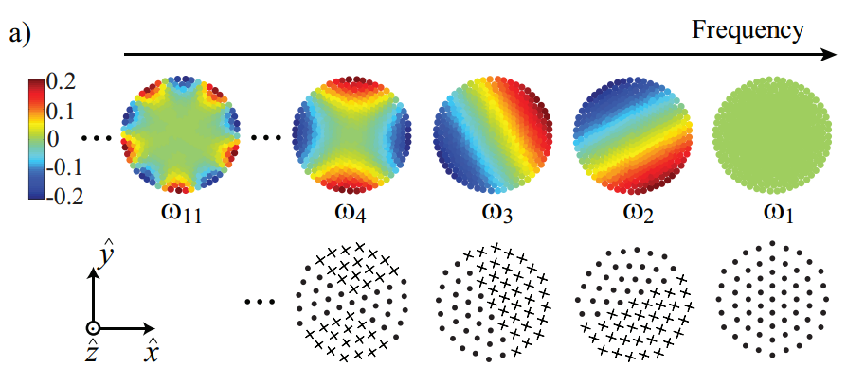
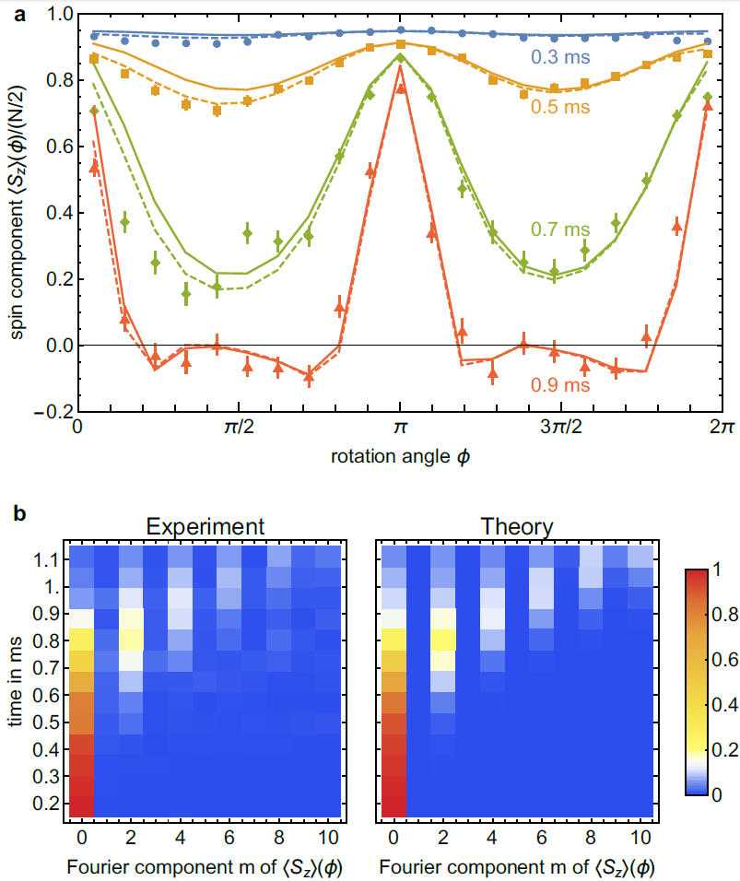
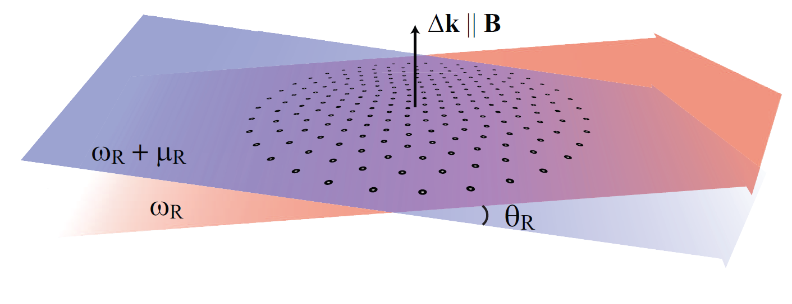
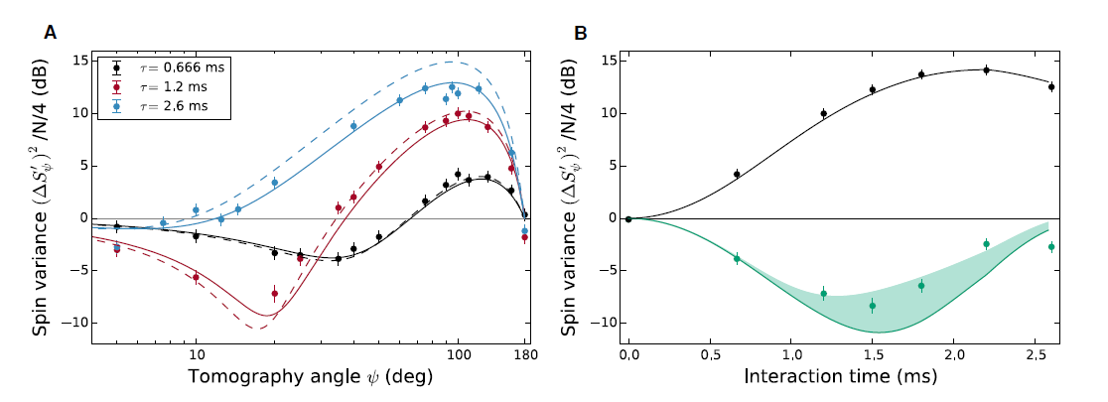
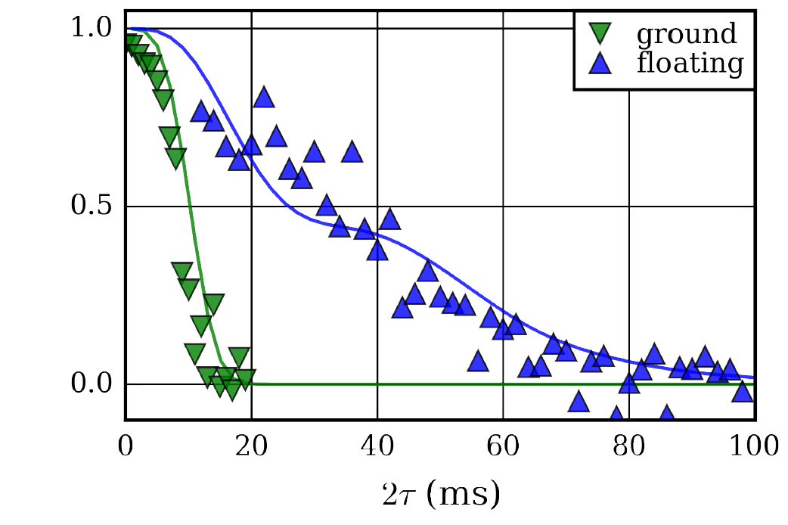
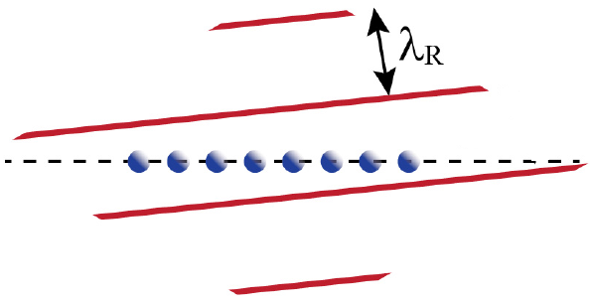
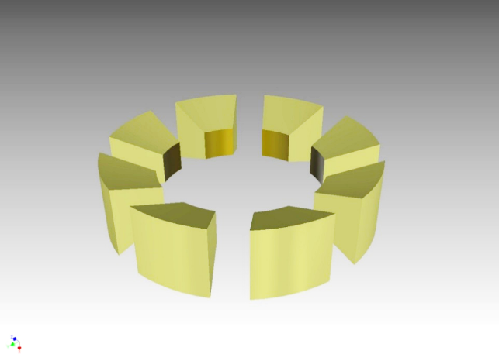
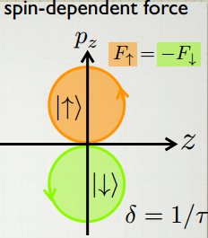
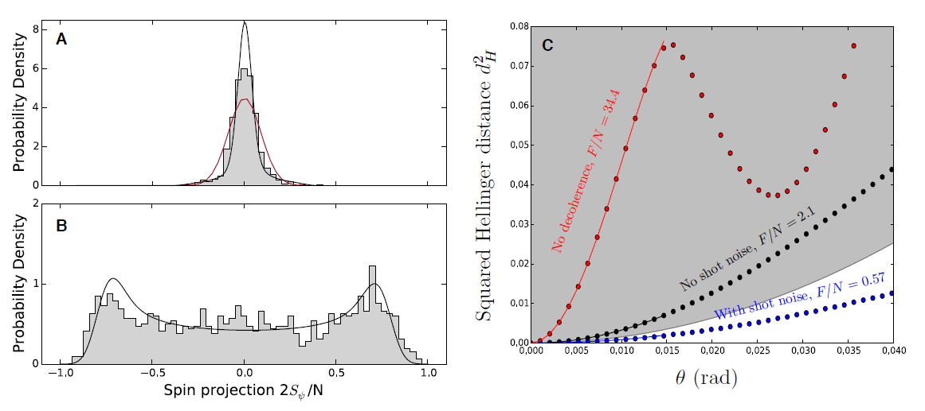
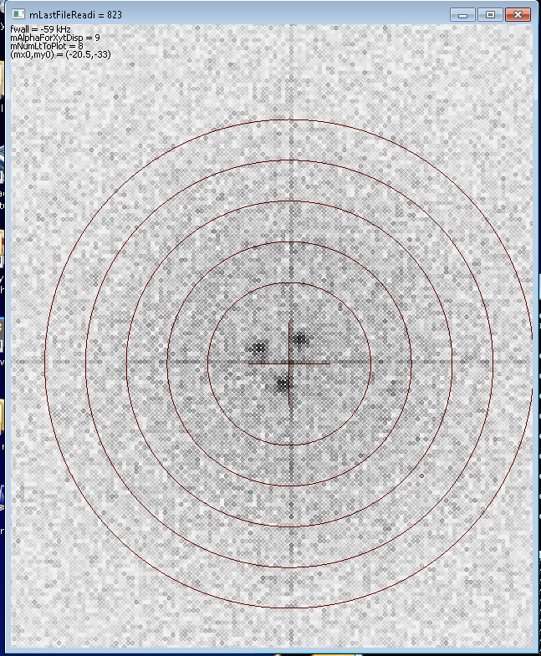
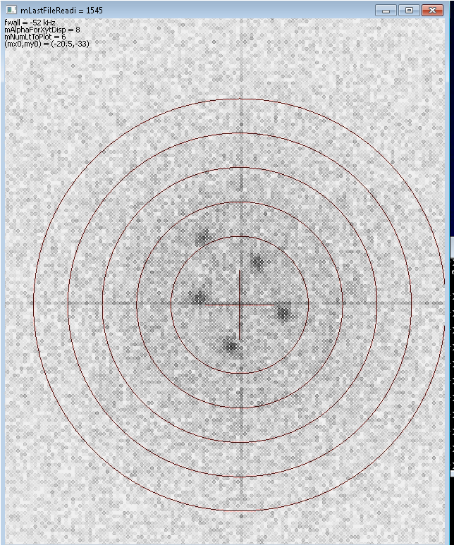
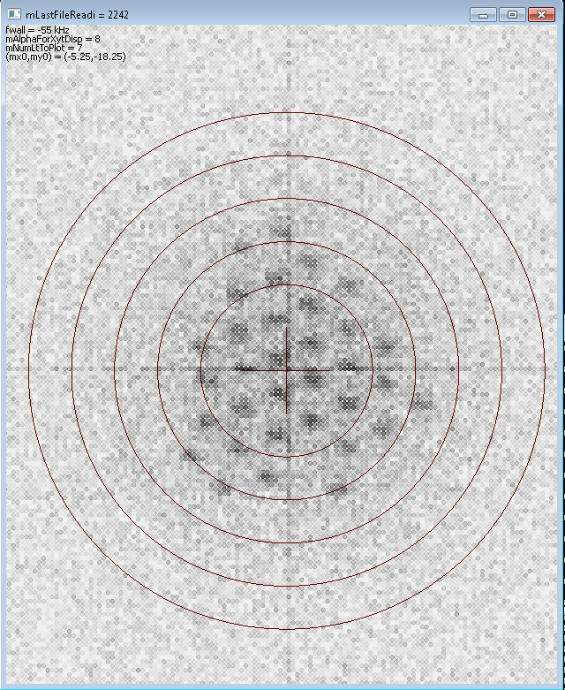




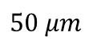
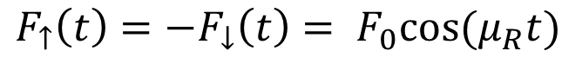
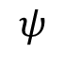
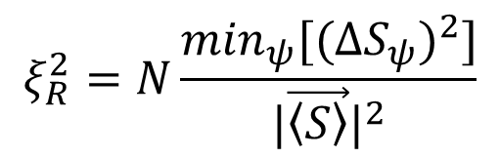
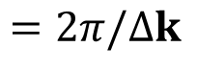
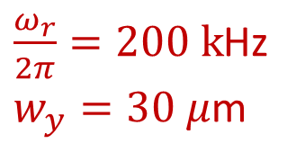
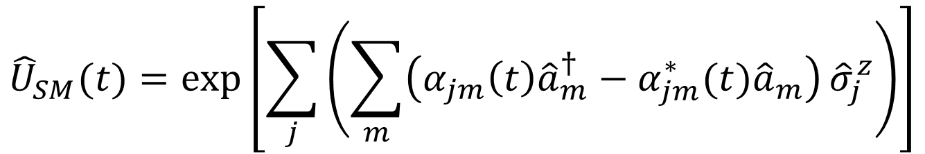
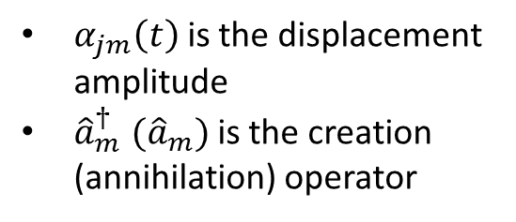
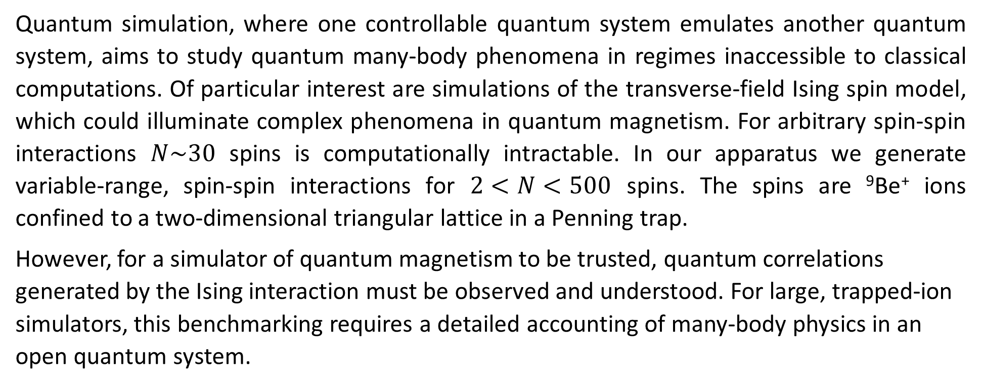
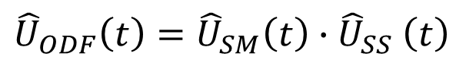
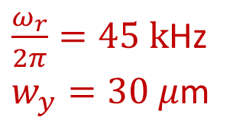
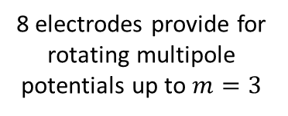
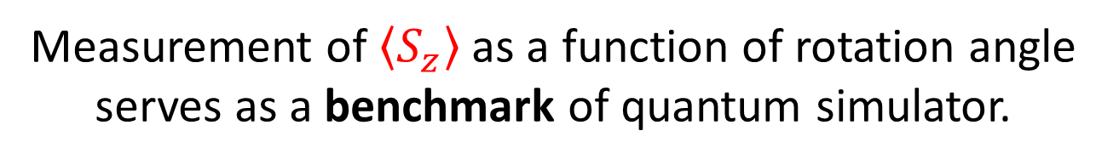
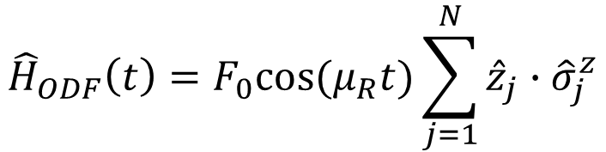
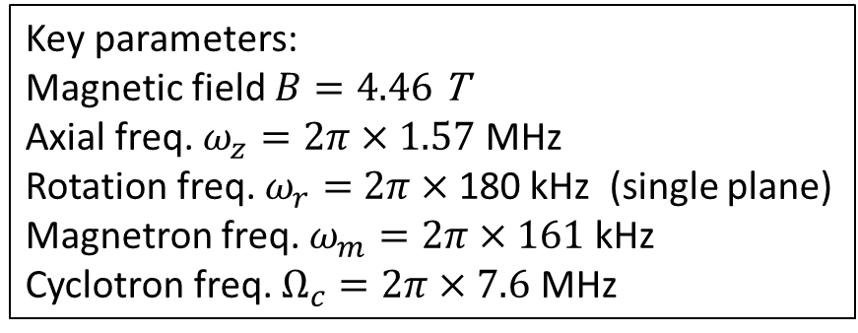
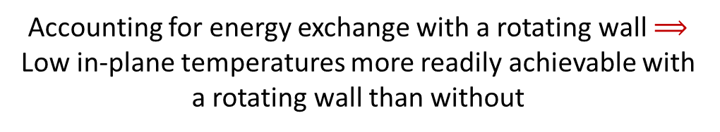
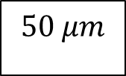
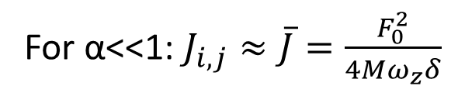
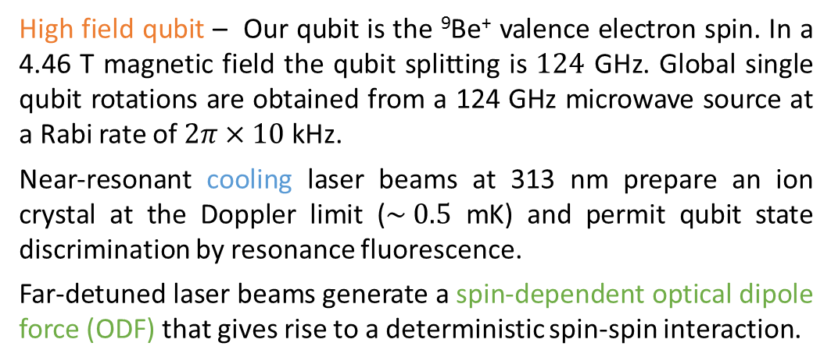
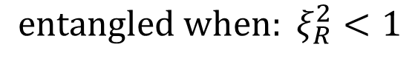
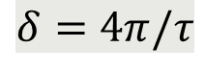
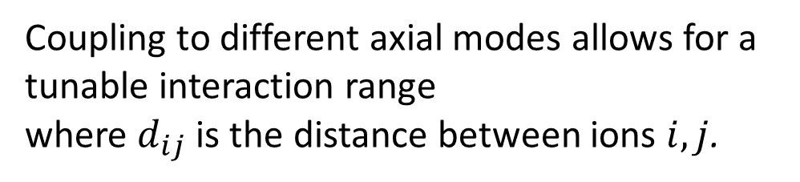
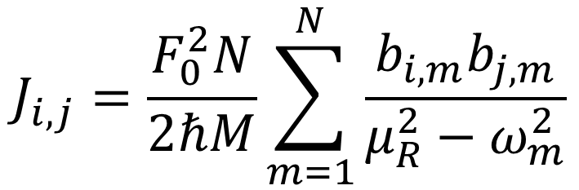
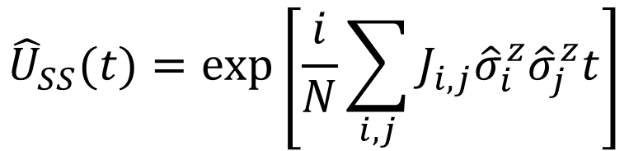
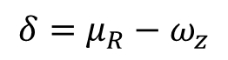
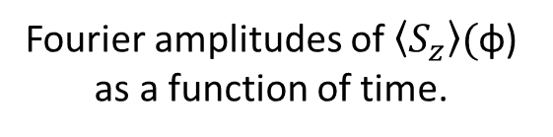
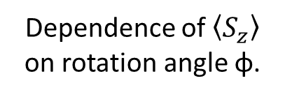
Motivation
Perpendicular laser cooling
with a rotating wall
Torrisi, Britton, Bohnet, Bollinger, PRA 93 (2016)
Spin squeezing and entanglement
Multiple quantum coherences
See M. Gärttner N4.00004
Quantum simulation, where one controllable quantum system emulates another quantum system, aims to study quantum many-body phenomena in regimes inaccessible to classical computations. Of particular interest are simulations of the transverse-field Ising spin model, which could illuminate complex phenomena in quantum magnetism. For arbitrary spin-spin interactions $N\sim 30$ spins is computationally intractable. In our apparatus we generate variable-range, spin-spin interactions for $2<N<500$ spins. The spins are ⁹Be⁺ ions confined to a two-dimensional triangular lattice in a Penning trap.
However, for a simulator of quantum magnetism to be trusted, quantum correlations generated by the Ising interaction must be observed and understood. For large, trapped-ion simulators, this benchmarking requires a detailed accounting of many-body physics in an open quantum system.
Bohnet, et al, arXiv:1512.03756 to be published in Science
Probe coherence and entanglement of quantum states with many-body echoes as in multiple quantum NMR (Baum, et al, J. Chem. Phys. (1985)). Useful for benchmarking quantum simulators and studying dynamics of higher order correlations MQC can provide a lower bound on quantum Fisher information, and therefor a multi-particle entanglement witness.
Benchmarking of quantum correlations and many-body physics in an open quantum system.
Experimental measurement of Ising spin dynamics demonstrating entanglement by observing spin squeezing. Examine interplay between correlations and decoherence.
Accounting for energy exchange with a rotating wall $⟹$
Low in-plane temperatures more readily achievable with
a rotating wall than without
Rotating wall provides an energy sink for the work done
by the perp beam in applying a torque
Overlap with initial state as a function of rotation angle yields oscillations from which the multiple quantum coherences are obtained.
Experimental Details
$\frac{ω_{r}}{2π}=45 k$Hz
$w_{y}=30 μ$m
2-D geometry for
perpendicular laser cooling
Experiment pulse sequence, composed of cooling laser pulses (blue), microwave pulses (grey), and ODF laser pulses (green).
Experimental sequence. Bloch spheres show evolution of state.
Lab frame CCD images
Observe depolarization of the collective spin.
Distinguish destruction of correlations caused by decoherence from coherent depolarization caused by spin-spin interaction.
Side view
Depolarization of the collective spin from spin-spin interactions and decoherence
Coherent Interactions
Coherent Ising interactions give rise to (over) squeezed state
$$100 μm$$
$$50 μm$$
Contours of equilibrium temperature (mK) with
a color plot of the perp laser torque (Joules)
Bottom view
Rotating frame from timed single photon counts
$\frac{ω_{r}}{2π}=200 k$Hz
$w_{y}=30 μ$m
Key parameters:
Magnetic field $B=4.46$ T
Axial freq. $ω_{z}=2π×1.57$ MHz
Rotation freq. $ω_{r}=$ $2π×$180 kHz (single plane)
Magnetron freq. $ω_{m}=2π×161$ kHz
Cyclotron freq. $Ω_{c}=2π×7.6$ MHz
Ising interaction with spin-dependent force
Decoherence
Two far-detuned laser beams produce a spin-dependent optical dipole force (ODF) at the ions that gives rise to a spin-spin interaction. Combined with a transverse magnetic field, we can realize non-trivial quantum magnetic interactions.
Decoherence leads to shortening of Bloch vector
Idealized fidelity signal for different evolution times τ.
Fourier transforms of the fidelity signals of (b). The Fourier amplitudes are identical with the multiple quantum coherences.
⁹Be⁺ qubit system
High field qubit – Our qubit is the ⁹Be⁺ valence electron spin. In a 4.46 T magnetic field the qubit splitting is $124$ GHz. Global single qubit rotations are obtained from a 124 GHz microwave source at a Rabi rate of $2π×10$ kHz.
Near-resonant cooling laser beams at 313 nm prepare an ion crystal at the Doppler limit ($\sim 0.5$ mK) and permit qubit state discrimination by resonance fluorescence.
Far-detuned laser beams generate a spin-dependent optical dipole force (ODF) that gives rise to a deterministic spin-spin interaction.
transverse B-field from
124 GHz microwaves
Coupling to different axial modes allows for a tunable interaction range
where $d_{ij}$ is the distance between ions $i, j$.
Plot: Contrast decay for N = 21, 58, and 144 ions (black circles, red squares, and blue diamonds). Black squares show contrast decay from decoherence due to spontaneous emission in the absence of spin-spin coupling.
Measurement of $\left\langle S_{z}\right\rangle$ as a function of rotation angle serves as a benchmark of quantum simulator.
Engineered Ising interaction from
spin-dependent ODF
Measure and benchmark modification of collective spin variance
and verify entanglement using spin-squeezing.
Coherence time
Dependence of $\left\langle S_{z}\right\rangle$ on rotation angle φ.
Fringe Contrast
$$F_{↑}\left(t\right)=−F_{↓}\left(t\right)= F_{0}cos⁡(μ_{R}t)$$
$$J_{i,j}=\frac{F_{0}^{2}N}{2ℏM}\sum_{m=1}^{N}{\frac{b_{i,m}b_{j,m}}{μ_{R}^{2}−ω_{m}^{2}}}$$
1D optical lattice wavefronts
$$=2π/Δk$$
spin-spin interaction
For α<<1: $J_{i,j}≈\overline{J}=\frac{F_{0}^{2}}{4Mω_{z}δ}$
N = 86 ± 2. Dashed lines are predictions assuming homogenous Ising interactions. Solid lines include decoherence from spontaneous emission.
Minimum (green points) and maximum (black points) spin variance
Britton et al., arXiv_1512.00801, to be published in PRA
Spin-motion entanglement
$$ξ_{R}^{2}=N\frac{\min_{ψ}[(ΔS_{ψ})^{2}]}{|\vec{\left\langle S\right\rangle }|^{2}}$$
$${entangled when: ξ}_{R}^{2}<1$$
Controlling few-ion 2D crystals with rotating potentials
$${\hat{H}}_{ODF}\left(t\right)=F_{0}cos⁡(μ_{R}t)\sum_{j=1}^{N}{{\hat{z}}_{j}{∙\hat{σ}}_{j}^{z}}$$
See A. Safavi-Naini N4.00005
$$ψ$$
Fourier amplitudes of $\left\langle S_{z}\right\rangle ($φ) as a function of time.
Detuning of ODF frequency difference from COM mode
$$δ=μ_{R}−ω_{z}$$
Observe non-Gaussian counting statistics in collective spin state.
Disappearance of spin-squeezing at long times consistent with formation of over-squeezed state - not just degradation due to decoherence.
We apply a controlled torque to the ion crystal using a weak ‘rotating wall’ potential. This radially asymmetric potential is produced using split ring electrodes at the axial trap center. Controlling the rotation frequency stabilizes the radial trapping potential, producing stable ions crystals in a well-defined rotating frame.
$${\hat{U}}_{ODF}\left(t\right)={\hat{U}}_{SM}\left(t\right){∙\hat{U}}_{SS}\left(t\right)$$
$${\hat{U}}_{SM}(t)=\exp\left[\sum_{j}{\left(\sum_{m}{\left(α_{jm}\left(t\right){\hat{a}}_{m}^{†}−α_{jm}^{∗}(t){\hat{a}}_{m}\right)}{\hat{σ}}_{j}^{z}\right)}\right]$$
Theory by M. Wall
8 electrodes provide for rotating multipole potentials up to $m=3$
Spin-motion entanglement
Decoherence in Bloch vector
Metrological tool
Large term for small detunings
$α_{jm}\left(t\right)$is the displacement amplitude
${{\hat{a}}_{m}^{†} (\hat{a}}_{m})$is the creation (annihilation) operator
Future Directions
$$δ=4π/τ$$
Transverse magnetic field
Sensitive force detection
Apply sub-Doppler cooling (EIT) to the axial drumhead modes
Residual spin-motional entanglement leads to shortening of the Bloch vector and is minimized at certain drive times for a given detuning.
$50 μm$
$${\hat{U}}_{SS}(t)=\exp\left[\frac{i}{N}\sum_{i,j}{J_{i,j}{\hat{σ}}_{i}^{z}{\hat{σ}}_{j}^{z}t}\right]$$
Spin-spin coupling
Ising interaction
Dominant for large detunings
Acknowledgements:
Images of different single-plane crystals in the rotating frame.
Composed of data from 1-2 seconds of integration.
Full counting statistics of a non-Gaussian spin state and theoretical Fisher information (F). Histograms showing
the (A) squeezed and (B) anti-squeezed quadratures of the collective spin of N = 127 ± 4 ions.

